Slide 1


Slide 2

Geography at
St. Louis
Why Choose GCSE Geography
at St. Louis?

Slide 3
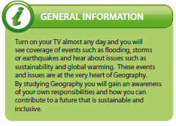
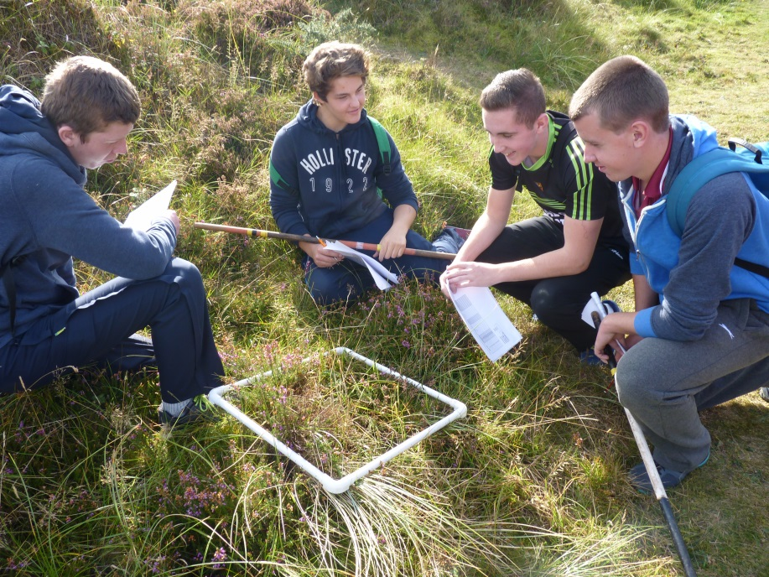
What is Geography?

Slide 4
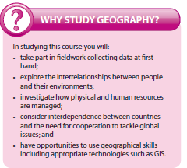
Why Study GCSE Geography?

Slide 5

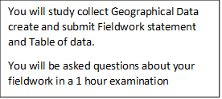
The Specification
Year 11
Year 12
40%
40%
You will study;
Population & Migration
Changing Urban Areas
Contrasts in World Development
Managing Our Environment
Unit 2
You will study;
River Environments
Coastal Environments
Our Changing Weather & Climate
study;
River Environments
Coastal Environments
Our Changing Weather & Climate
CCEA
20%

Slide 6
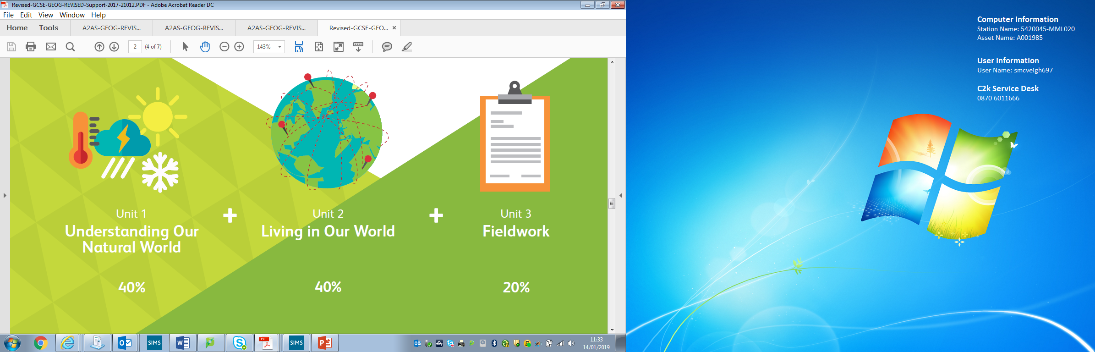
Assessment
Year 11
Unit 2
Year 12
Units 1 & 3
For Units 1 & 2 you will sit an examination lasting 1 hour and 30 minutes.
Questions will relate to all themes and will be range from source response questions to case study questions.

Slide 7
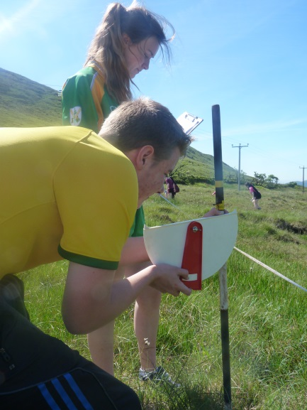
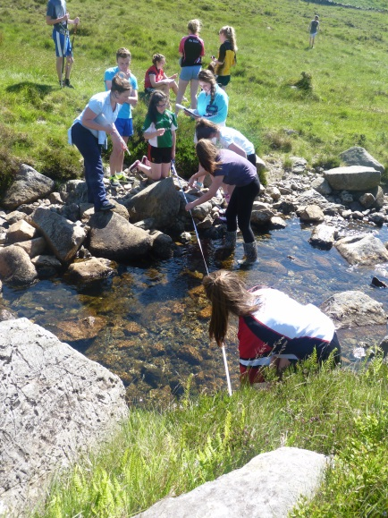
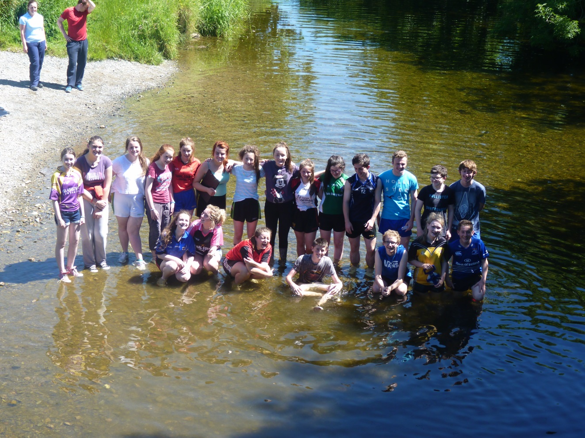
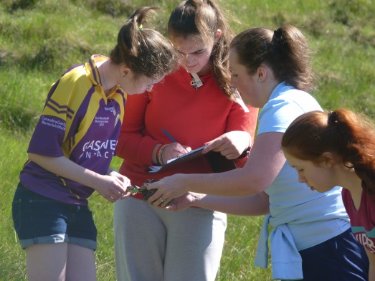
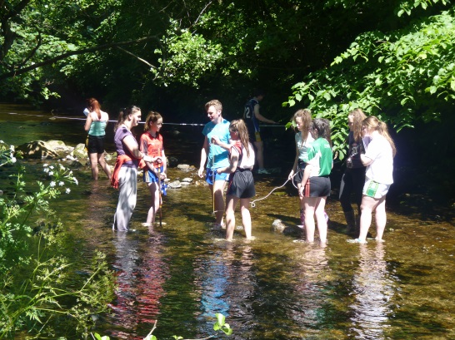
White Water River Investigation

Slide 8
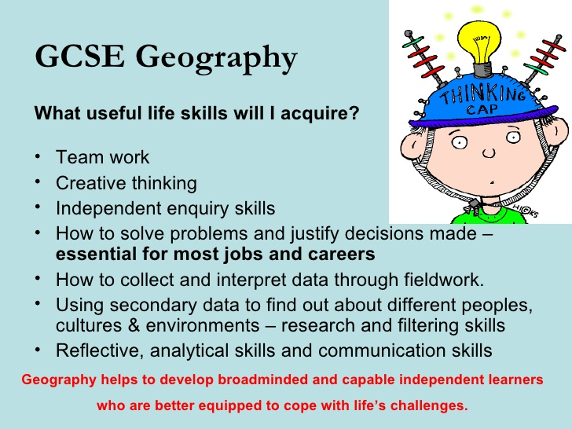

Slide 9

What can I do with Geography?

Slide 10

Careers with Geography

Slide 11


Slide 12
Further Information
Please view these youtube videos made by other institutions
Why Choose GCSE Geography?
https://youtu.be/5FVgg_u3auA
Why study Geography
https://youtu.be/t_a5OLScri0
You should make a point of visiting the Geography website of your exam board CCEA;
Snapshot_19.pdf (ccea.org.uk)

